Slide 1
Concurrency Control and Recovery Techniques
Dr. S. RENUKA DEVI
Associate Professor
SCSE
VIT Chennai Campus

Slide 2
Why Concurrency Control?
To ensure the non-interference or isolation property of concurrently executing transactions

Slide 3
Lock based Protocols
One way to ensure isolation is to require that data items be accessed in a mutually exclusive manner
Locks are used as a means of synchronizing the access by concurrent transactions to the database items
To ensure isolation, allow a transaction to access a data item only if it is currently holding a lock on that item
Two modes of Lock
Shared - If a transaction Ti has obtained a shared-mode lock (denoted by S) on item Q, then Ti can read, but cannot write, Q
Exclusive - If a transaction Ti has obtained an exclusive-mode lock (denoted by X) on item Q, then Ti can both read and write Q

Slide 4
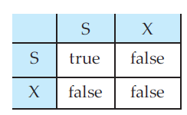
Lock compatibility matrix
Every transaction makes a request to the concurrency-control manager obtain an appropriate lock on data item Q
The transaction can proceed with the operation only after the concurrency-control manager grants the lock to the transaction
If transaction Ti can be granted a lock on Q immediately, in spite of the presence of the mode B lock, then we say mode A is compatible with mode B.

Slide 5
Locks
A transaction requests a shared lock on data item Q by executing the lock-S(Q) instruction
Similarly, a transaction requests an exclusive lock through the lock-X(Q) instruction
A transaction can unlock a data item Q by the unlock(Q) instruction
To access a data item, transaction Ti must first lock that item
If the data item is already locked by another transaction in an incompatible mode, then Ti is made to wait until all incompatible locks held by other transactions have been released

Slide 6
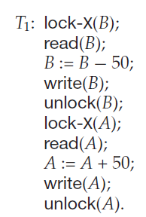
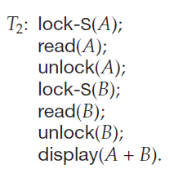
Lock – Example

Slide 7
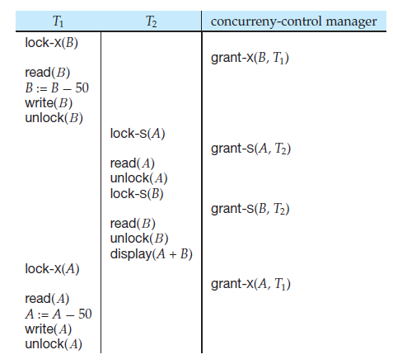
Lock – Example
the transaction T1
unlocked data item B
too early, as a result of
which T2 is in
inconsistent state

Slide 8
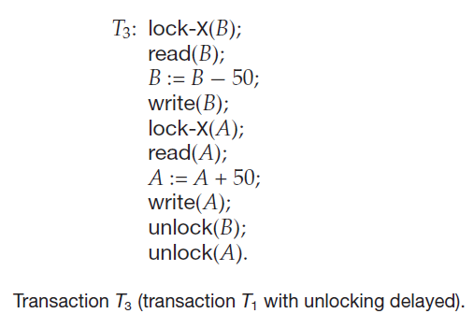
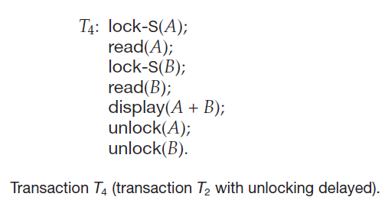
Lock – Example

Slide 9
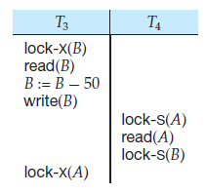
Deadlock
Unfortunately, locking can lead to an undesirable situation – deadlock
When deadlock occurs, the system must roll back one of the two transactions
Once a transaction has been rolled back, the data items that were locked by that transaction are unlocked
These data items are then available to the other transaction, which can continue with its execution

Slide 10
Granting of Locks
When a transaction Ti requests a lock on a data item Q in a particular mode M, the concurrency-control manager grants the lock provided that:
There is no other transaction holding a lock on Q in a mode that conflicts with M
There is no other transaction that is waiting for a lock on Q and that made its lock request before Ti

Slide 11
The Two-Phase Locking Protocol
Ensures serializability
It requires that each transaction issue lock and unlock requests in two phases:
Growing phase. A transaction may obtain locks, but may not release any lock
Shrinking phase. A transaction may release locks, but may not obtain any new locks
The point in the schedule where the transaction has obtained its final lock (the end of its growing phase) is called the lock point of the transaction

Slide 12
Two Phase Locking – Examples
T1:
lock-X(B);
read(B);
B := B − 50;
write(B);
lock-X(A);
read(A);
A := A + 50;
write(A);
unlock(B);
unlock(A)
T2:
lock-S(A);
read(A);
lock-S(B);
read(B);
display(A + B);
unlock(A);
unlock(B)

Slide 13
Variations of Locking Protocols
Strict two-phase locking protocol - all exclusive-mode locks taken by a transaction be held until that transaction commits
Cascading rollbacks can be avoided through this protocol
Another variant of two-phase locking is the rigorous two-phase locking protocol, which requires that all locks be held until the transaction commits

Slide 14
Lock conversions
A mechanism for upgrading a shared lock to an exclusive lock, and downgrading an exclusive lock to a shared lock.
We denote conversion from shared to exclusive modes by upgrade, and from exclusive to shared by downgrade
Lock conversion cannot be allowed arbitrarily
Rather, upgrading can take place in only the growing phase, whereas downgrading can take place in only the shrinking phase

Slide 15
Database Recovery
Recovery from transaction failures usually means that the database is restored to themost recent consistent state just before the time of failure.
To do this, the system log is required.
Conceptually, we can distinguish two main techniques for recovery from noncatastrophic transaction failures:
Deferred update
Immediate update

Slide 16
Deferred Update
The deferred update techniques do not physically update the database on disk until after a transaction reaches its commit point
Before reaching commit, all transaction updates are recorded in the local transaction workspace or in the main memory buffers
Before commit, the updates are recorded persistently in the log, and then after commit, the updates are written to the database on disk.
If a transaction fails before reaching its commit point, it will not have changed the database in any way, so UNDO is not needed.
It may be necessary to REDO the effect of the operations of a committed transaction from the log, because their effect may not yet have been recorded in the database on disk.
Hence, deferred update is also known as the NO-UNDO/REDO algorithm.

Slide 17
Immediate Update
In the immediate update techniques, the database may be updated by some operations of a transaction before the transaction reaches its commit point.
However, these operations must also be recorded in the log on disk, making recovery still possible.
If a transaction fails after recording some changes in the database on disk but before reaching its commit point, the effect of its operations on the database must be undone; i.e., the transaction must be rolled back.
In general, both undo and redo may be required during recovery. Hence this technique is known as the UNDO/REDO algorithm
The UNDO and REDO operations are required to be idempotent—that is, executing an operation multiple times is equivalent to executing it just once.

Slide 18
Checkpoints in the System Log
Another type of entry in the log is called a checkpoint.
A [checkpoint, list of active transactions] record is written into the log periodically at that point when the system writes out to the database on disk all DBMS buffers that have been modified.
As a consequence of this, all transactions that have their [commit, T ] entries in the log before a [checkpoint] entry do not need redone in case of a system crash, since all their updates will be recorded in the database on disk during checkpointing.
The recovery manager of a DBMS must decide at what intervals to take a checkpoint.

Slide 19
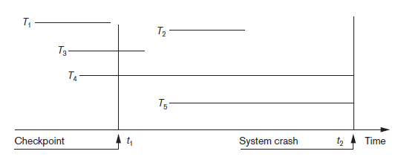
An Example illustrating the effect of Checkpoint

Slide 20
Recovery Techniques Based on Immediate Update
In these techniques, when a transaction issues an update command, the database on disk can be updated immediately, without any need to wait for the transaction to reach its commit point.
Theoretically, we can distinguish two main categories of immediate update algorithms. I
If the recovery technique ensures that all updates of a transaction are recorded in the database on disk before the transaction commits, there is never a need to REDO any operations of committed transactions. This is called the UNDO/NO-REDO recovery algorithm.
If the transaction is allowed to commit before all its changes are written to the database, we have the most general case, known as the UNDO/REDO recovery algorithm. (equivalent to Deferred Update)

Slide 21
Any Queries?

